Slide 1
SMA &
HULL TRADING
Week 3

Slide 2
Today’s Outline
S-Volume Analysis
2. Stationarity
3. Feature Engineering
4. Conclusion

Slide 3
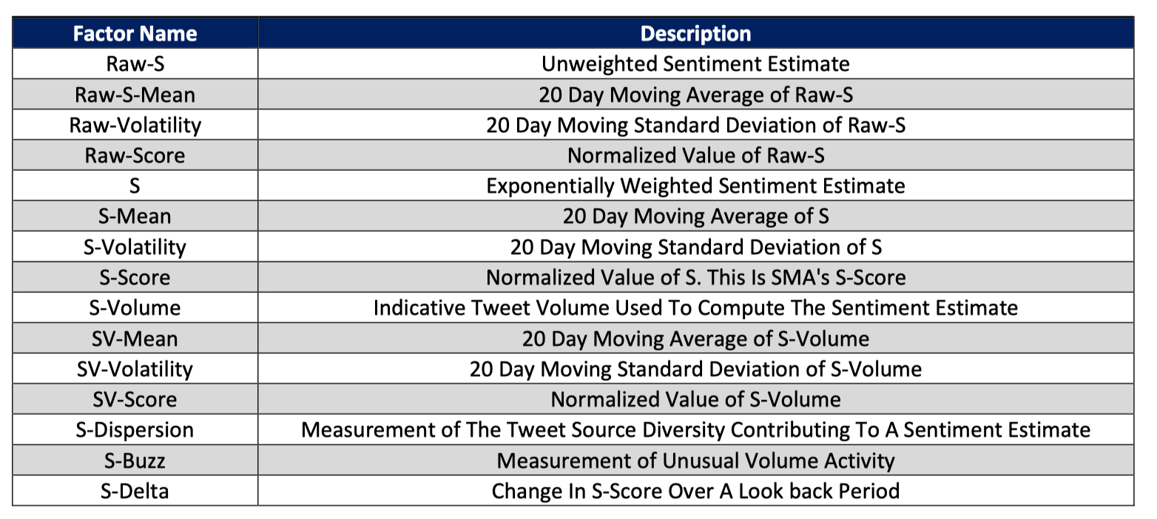
Data Factors

Slide 4
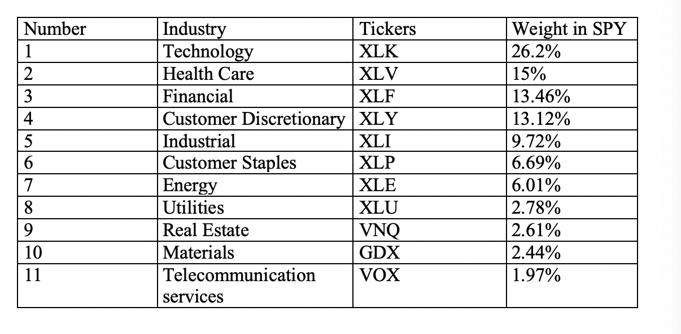
Data Selection

Slide 5
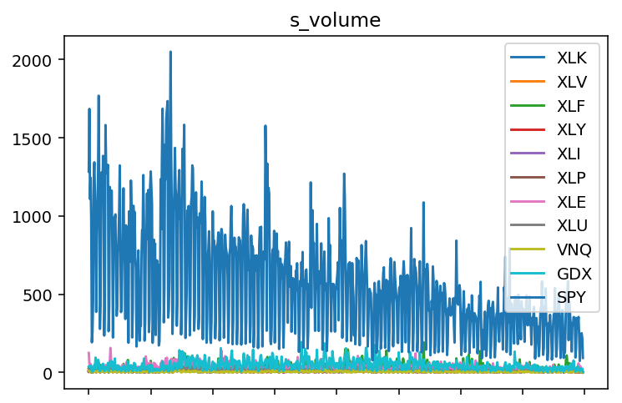
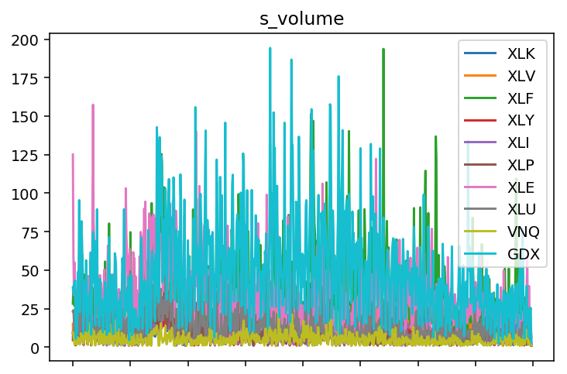
2. S-Volume Analysis
Trends across different industry
Notes:
SPY has the highest volume

Slide 6
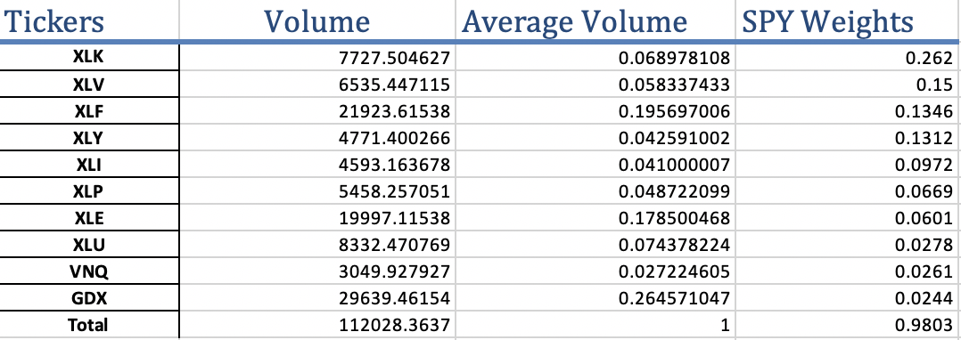
2. S-Volume Analysis

Slide 7
Notes:
SPY s_volume

Slide 9
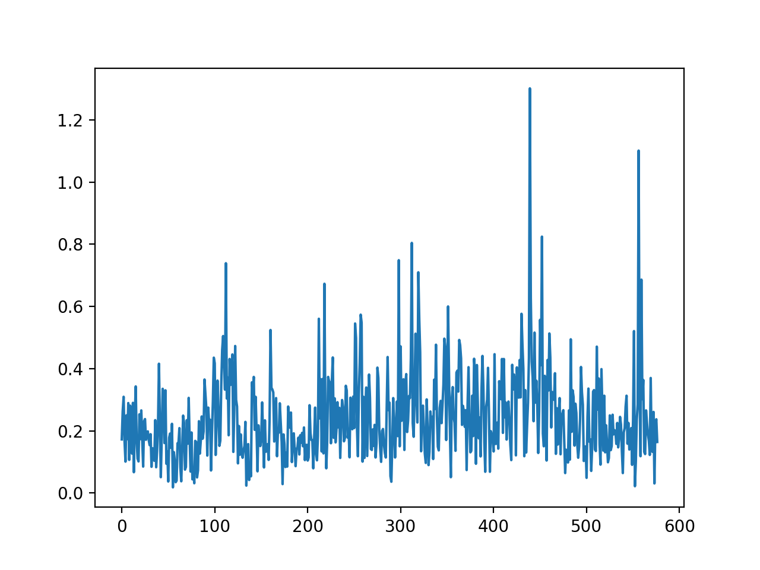
2. Stationarity
S_Volume
Ticker | p_value | Result
XLK | 0.000037 | Stationary
XLV | 0.000041 | Stationary
XLF | 0.000141 | Stationary
XLY | 0.000004 | Stationary
XLI | 0.000003 | Stationary
XLP | 0.005685 | Stationary
XLE | 0.072781 | Non-stationary
XLU | 0.000231 | Stationary
VNQ | 0.008535 | Stationary
GDX | 0.00958 | Stationary
Notes:
p-value > 0.05: Fail to reject the null hypothesis (H0), the data has a unit root and is non-stationary.
p-value <= 0.05: Reject the null hypothesis (H0), the data does not have a unit root and is stationary.

Slide 10
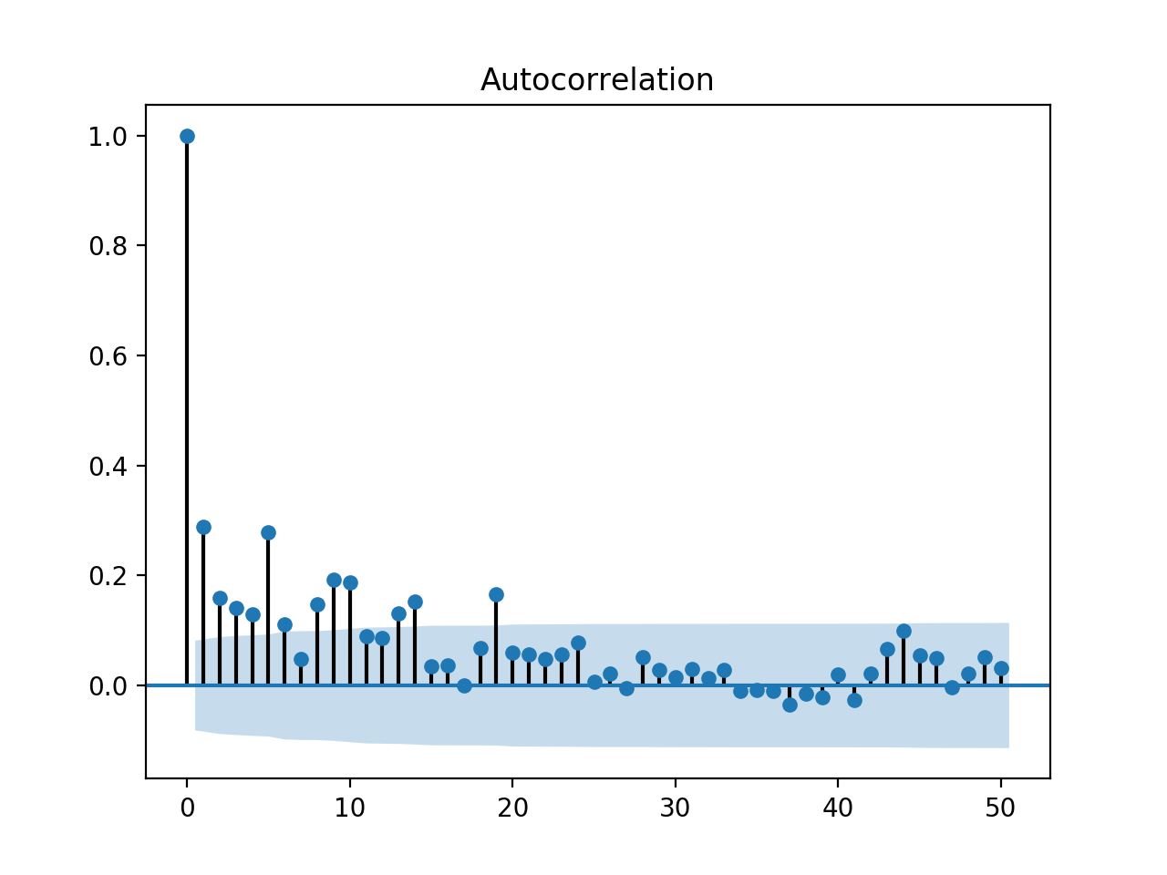
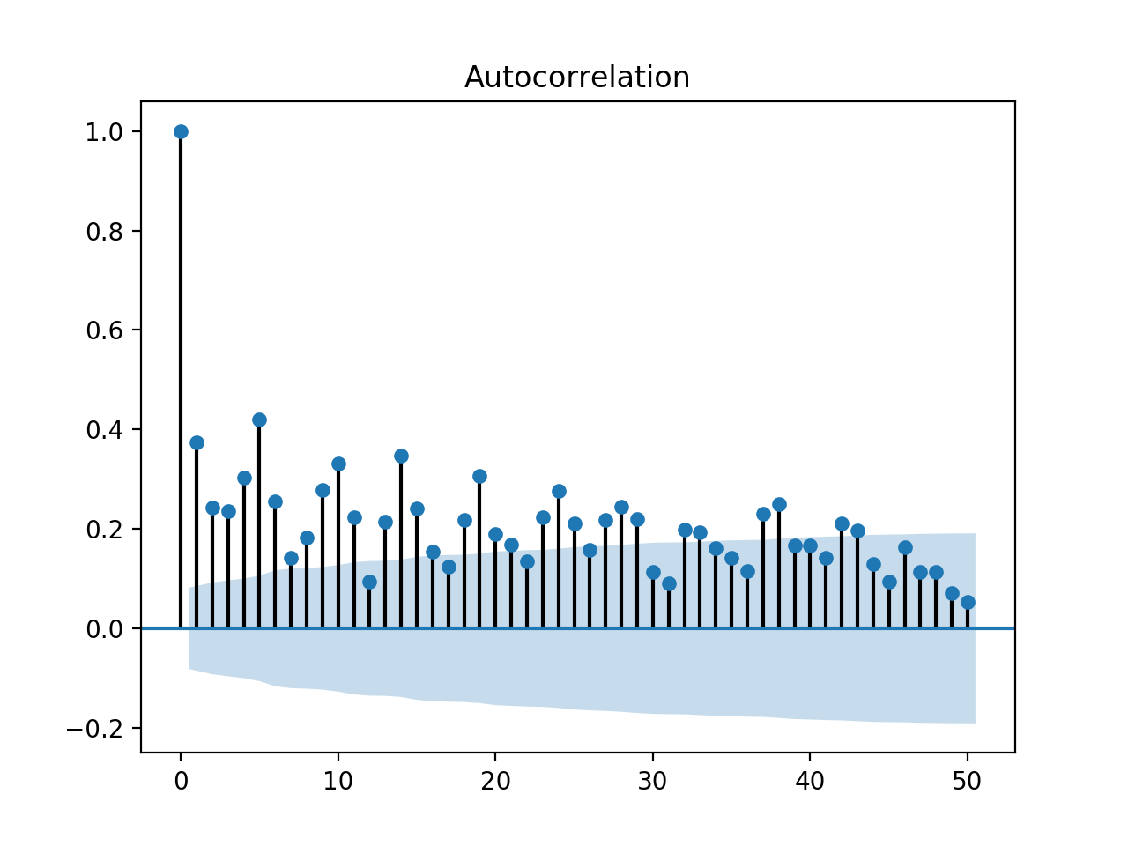
XLK
XLE

Slide 11
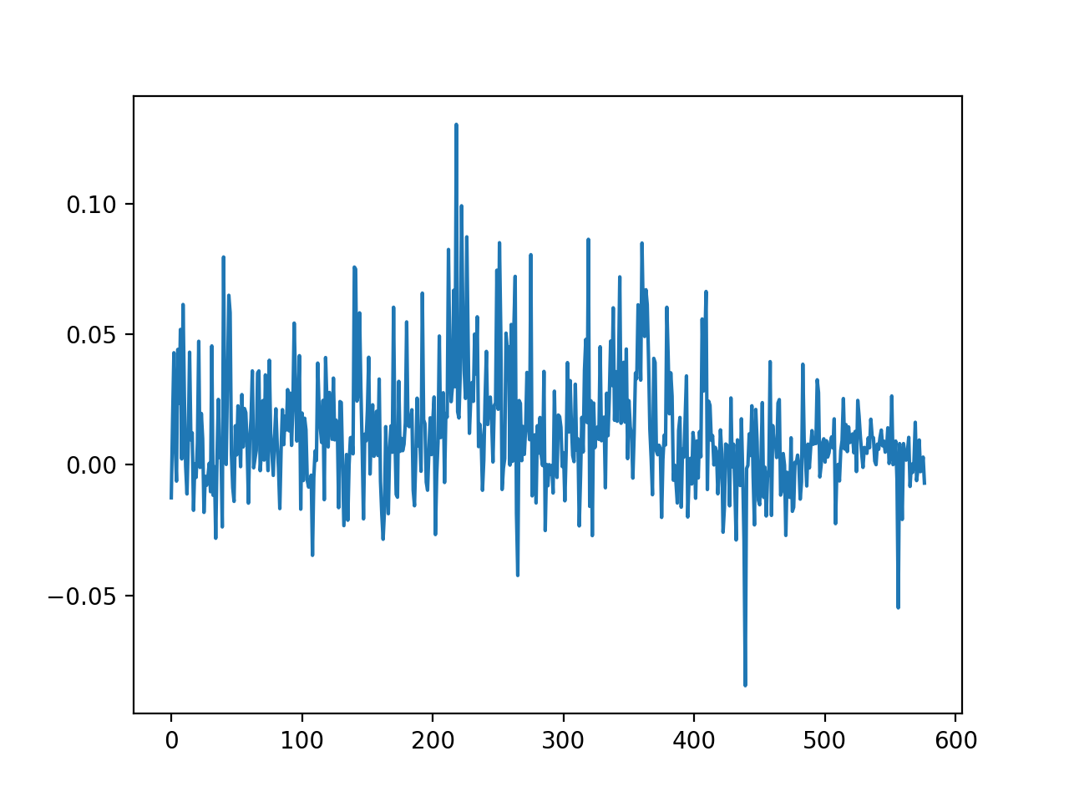
2. Stationarity
Raw_s
Ticker | p_value | Result
XLK | 0.000000 | Stationary
XLV | 0.000000 | Stationary
XLF | 0.000000 | Stationary
XLY | 0.000000 | Stationary
XLI | 0.000000 | Stationary
XLP | 0.025695 | Stationary
XLE | 0.000000 | Stationary
XLU | 0.000000 | Stationary
VNQ | 0.000000 | Stationary
GDX | 0.000004 | Stationary
Notes:
p-value > 0.05: Fail to reject the null hypothesis (H0), the data has a unit root and is non-stationary.
p-value <= 0.05: Reject the null hypothesis (H0), the data does not have a unit root and is stationary.

Slide 12
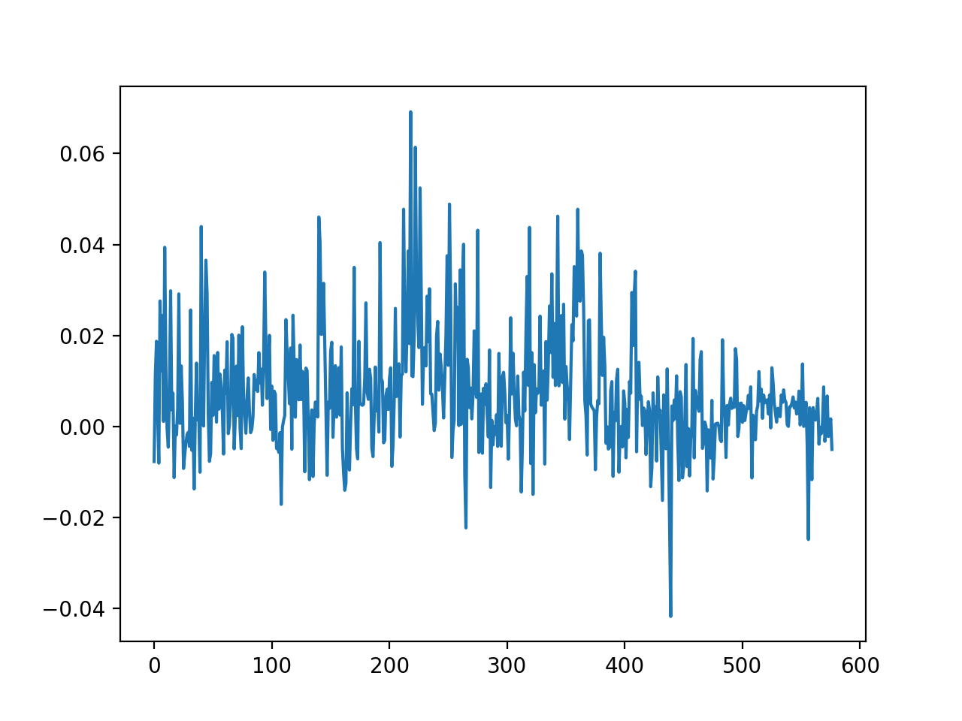
2. Stationarity
s
Ticker | p_value | Result
XLK | 0.000000 | Stationary
XLV | 0.000000 | Stationary
XLF | 0.000000 | Stationary
XLY | 0.000000 | Stationary
XLI | 0.001671 | Stationary
XLP | 0.078594 | Non-Stationary
XLE | 0.000000 | Stationary
XLU | 0.000000 | Stationary
VNQ | 0.000009 | Stationary
GDX | 0.000006 | Stationary
Notes:
p-value > 0.05: Fail to reject the null hypothesis (H0), the data has a unit root and is non-stationary.
p-value <= 0.05: Reject the null hypothesis (H0), the data does not have a unit root and is stationary.

Slide 13
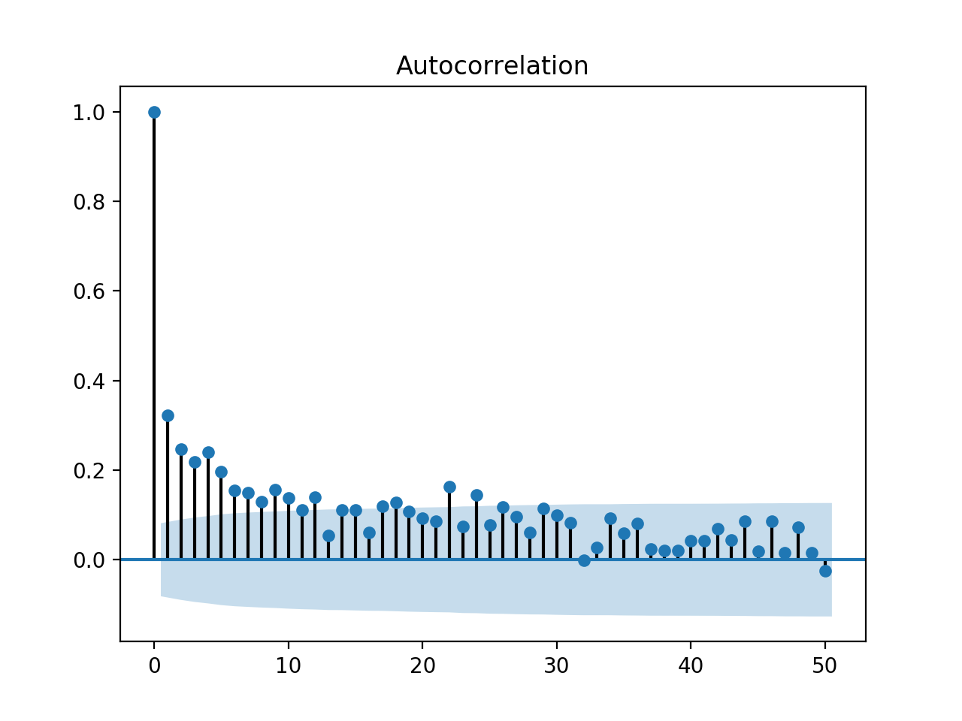
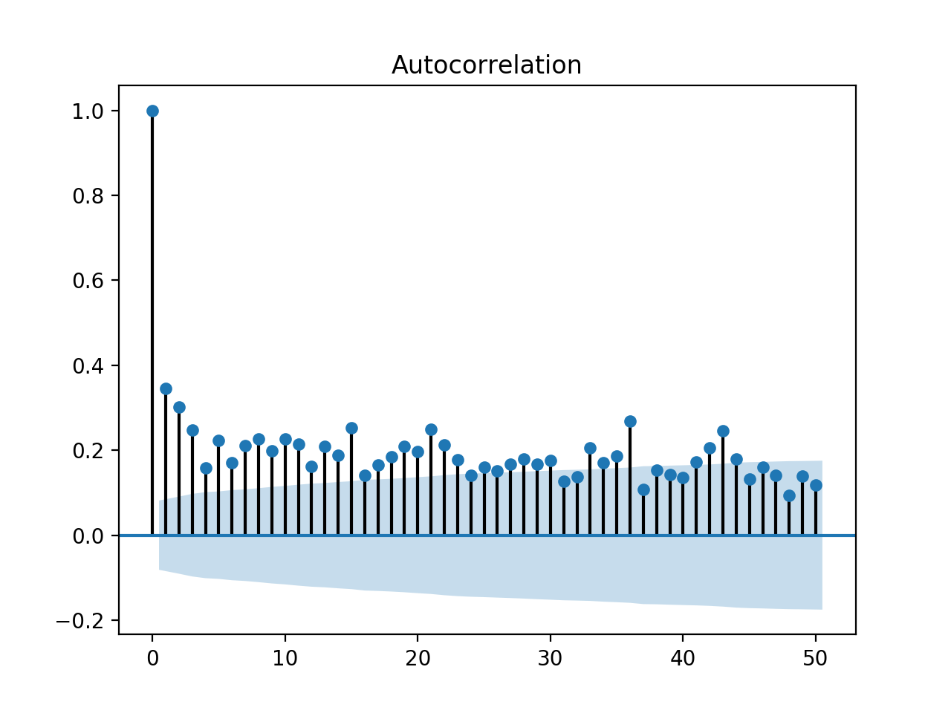
XLK
XLP

Slide 14
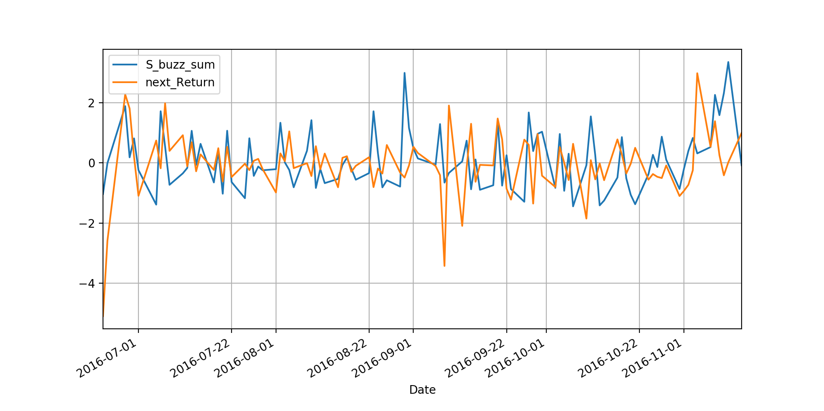
3. Feature Engineering

Slide 15
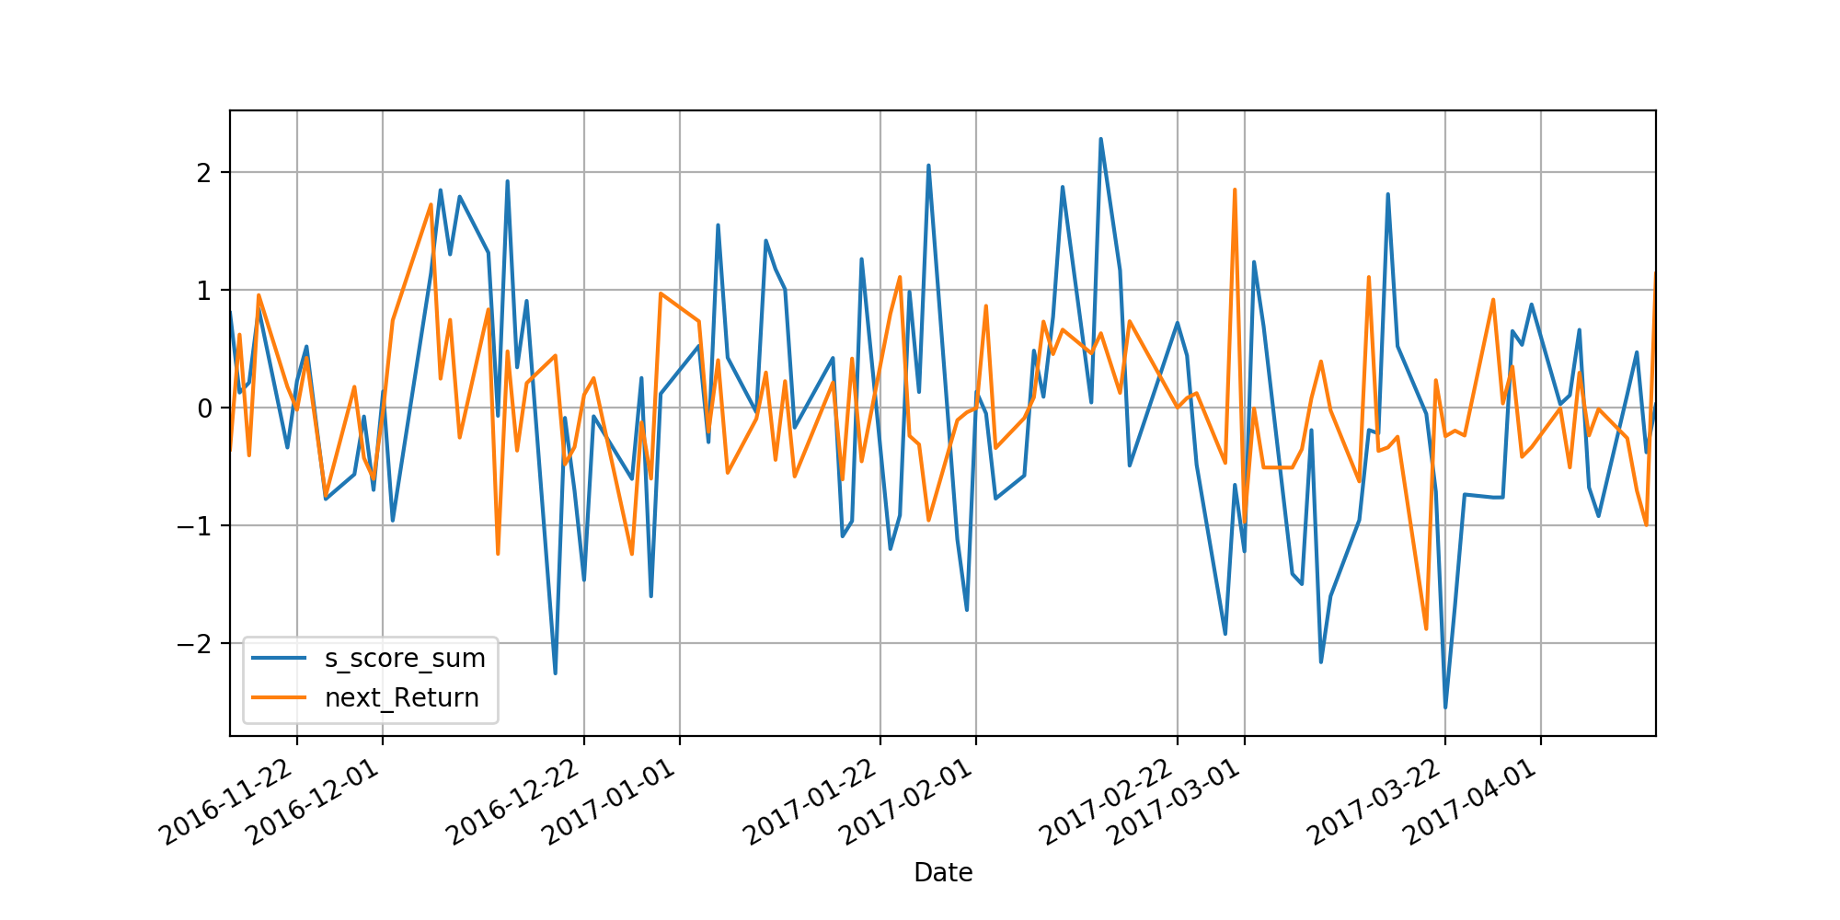
3. Feature Engineering

Slide 16
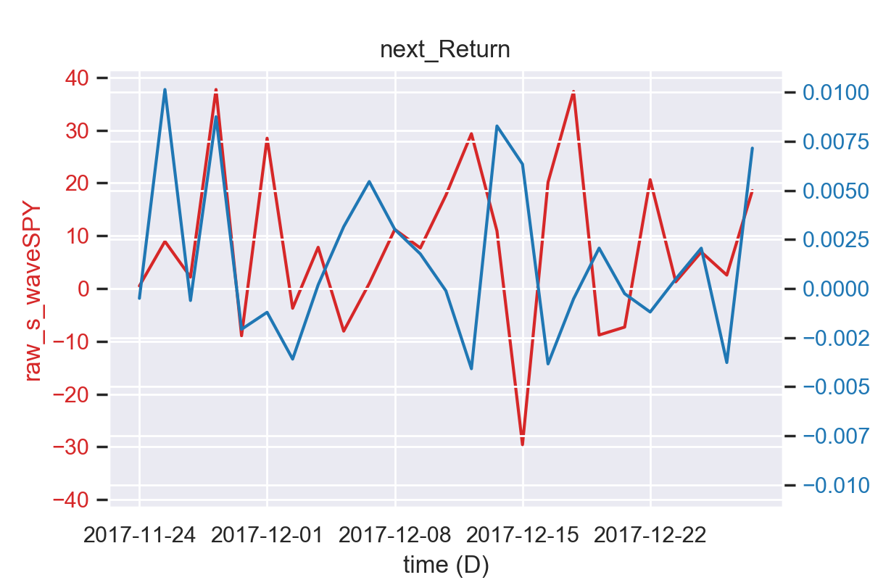
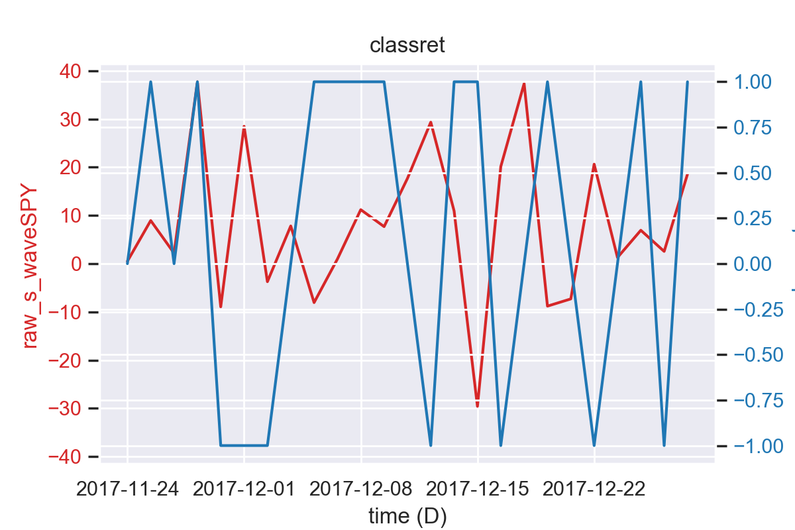
25 Days New Data-wave

Slide 17
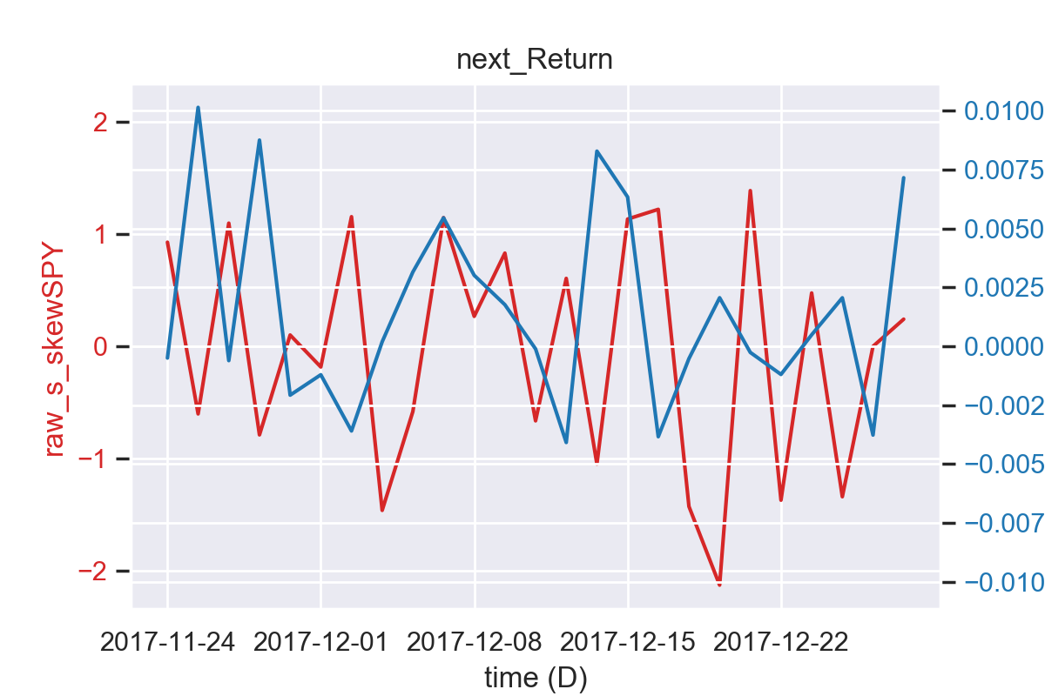
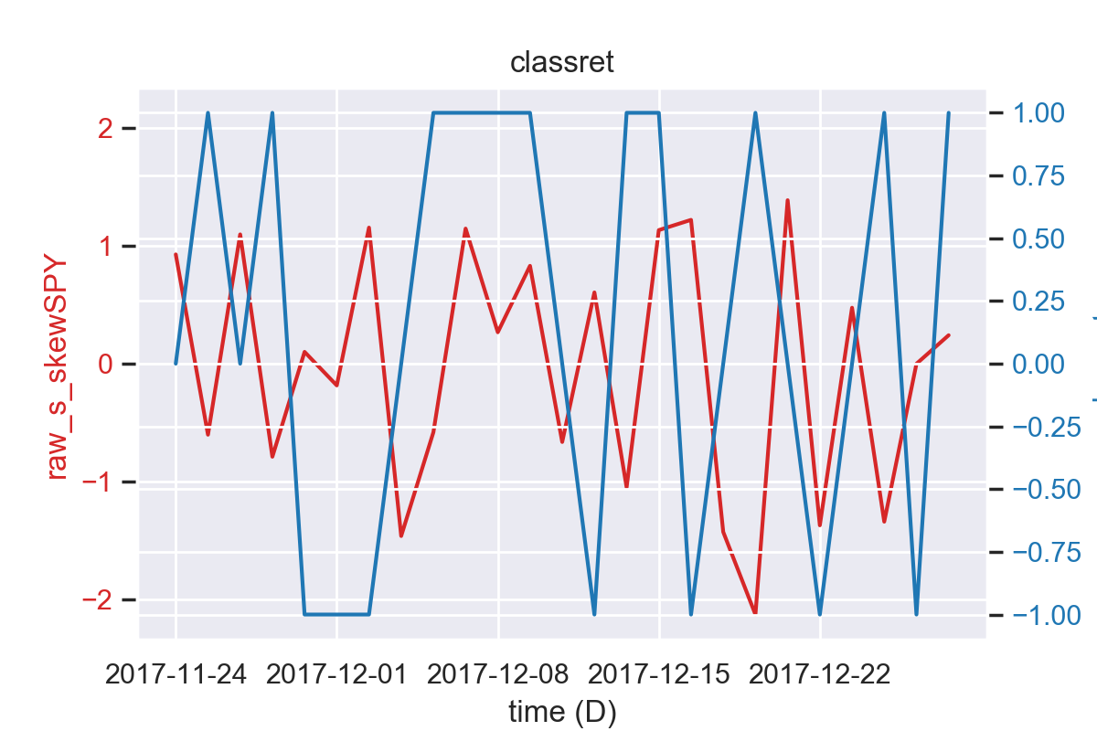
25 Days New Data-skew

Slide 18
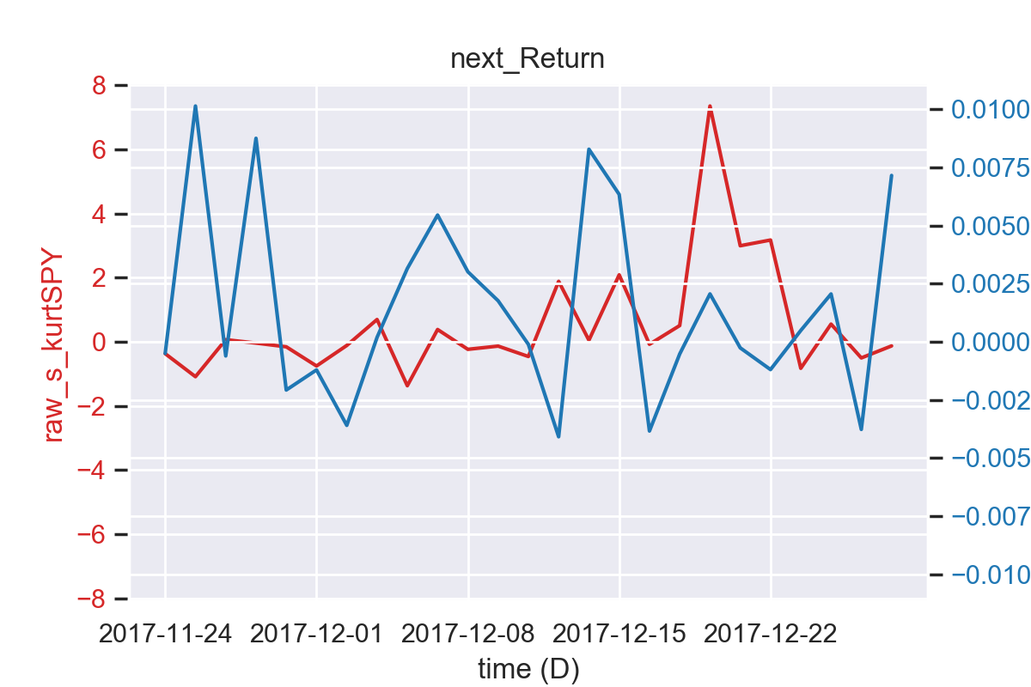
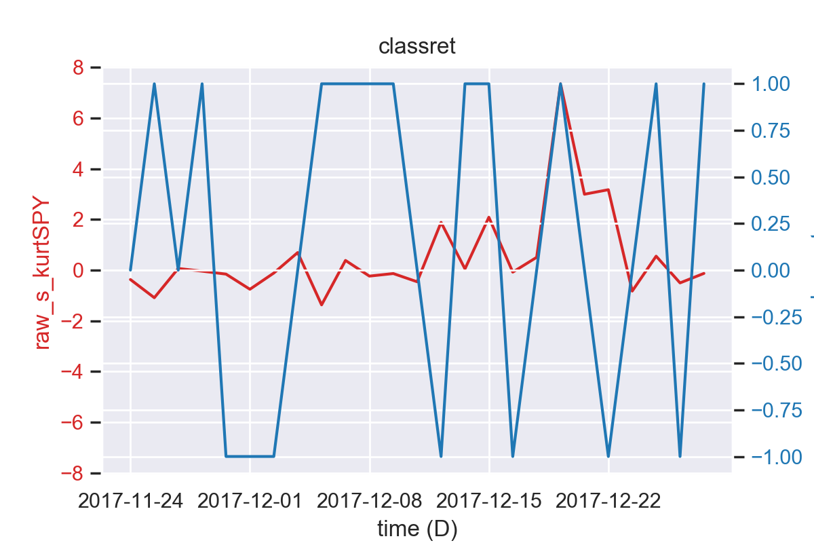
25 Days New Data-kurt

Slide 19
Classes
score | Return
2 | R>sd(AllReturns)*2
1 | sd(AllReturns)*2>R>sd(AllReturns)*0.5
0 | sd(AllReturns)*0.5>R>sd(AllReturns)*-0.5
-1 | sd(AllReturns)*-0.5>R>sd(AllReturns)*-2
-2 | R<sd(AllReturns)*-2

Slide 20
Conclusion
Majority of the data is stationary so we can potentially use time-series models
Rebalance the weights based on both SPY weights and S_volume
Incorporate intra-day features for forecasting.
Dimensionality reduction using techniques such as PCA needs to be implemented for feature selection.

